Slide 1

Entrepreneur Consulting LLC.
Charleen - Alicia - Janie - Jose

Slide 2










Our Vision
To become the premier strategic business planning tool for aspiring & existing entrepreneurs.
Capabilities Used
Charleen
Alicia
Janie
Jose

Slide 3
Entrepreneur Consulting LLC
Client Journey
Client develops a potential business idea
Client begins business planning process & seeks for resources
Entrepreneur Consulting LLC provides services new/ existing entrepreneurs seeking to grow business through strategic business planning
Services offered
New Entrepreneurs
Existing Entrepreneurs
Web based application that will help them develop optimal 4 P’s of marketing
Ongoing weekly report that provides market landscape update

Slide 4
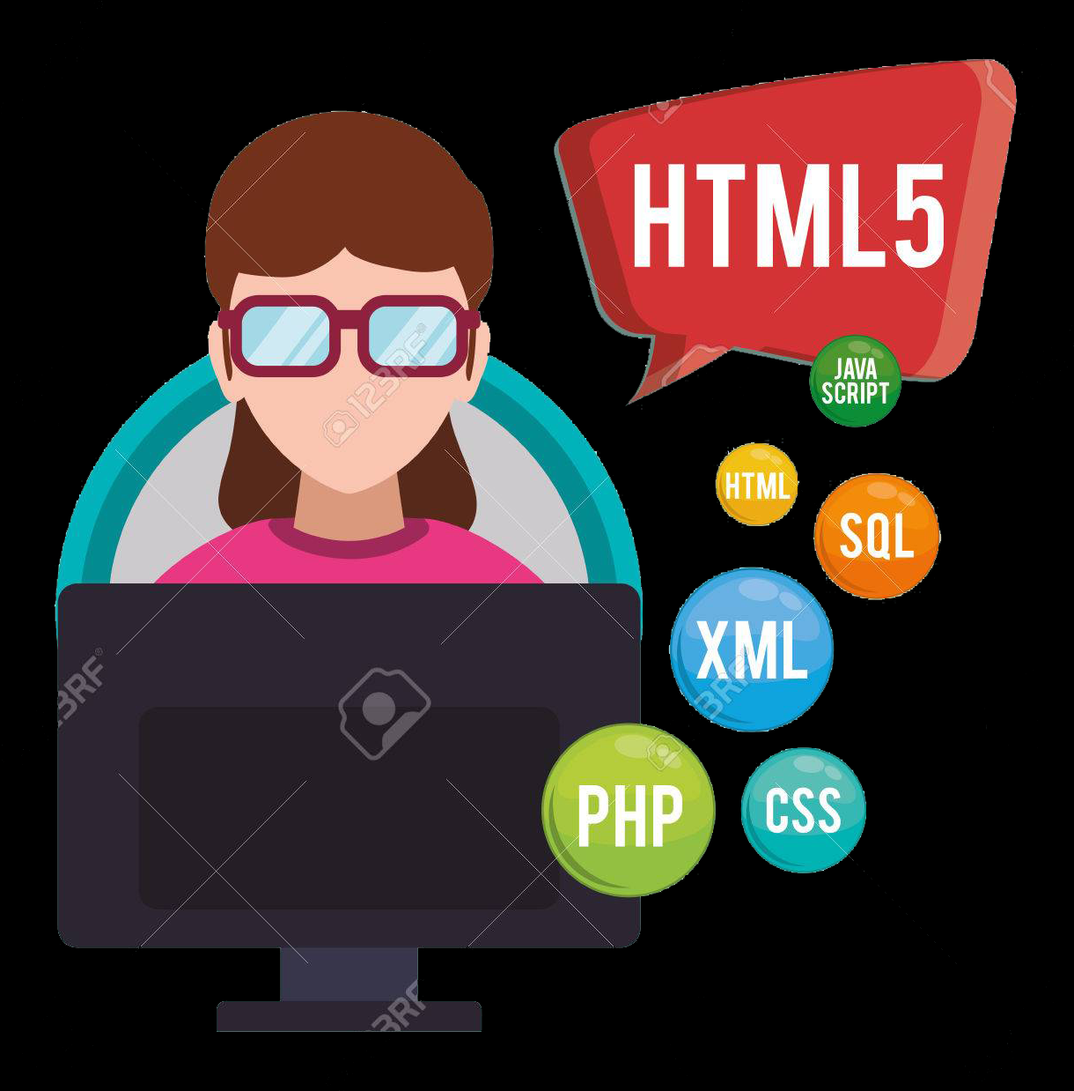

Our Approach
Data Cleansing & Prep
Development

Slide 5


Data Sources
Nielsen Syndicated Data
30,000+ rows of data
650,000+ data points
Three years worth of data
150+ categories by state

Slide 6
Data Cleansing
Insert Image/ Screenshot Here
Looped through “x” amount of files and consolidated data into 1 file
Removed NaN values from dataset
Created calculations (% Change & Index) versus year ago
Removed formatting
Etc.
Etc.

Slide 7
Loading to Database
Insert Image/ Screenshot of cleansed dataframe

Slide 8
Loading to Database
Insert screenshot of application

